Slide 1
Where Clause
- Morshedul Arefin

Slide 2
Where Clause
SELECT column_name(s) FROM table_name WHERE column_name operator value
Example:
$statement = $conn->prepare("SELECT * FROM students WHERE lastname=?");
$statement->execute(['Johnson']);
$result = $statement->fetchAll(PDO::FETCH_ASSOC);

Slide 3
Where Clause (…)
$statement = $conn->prepare("SELECT * FROM students WHERE id > ?");
$statement->execute([3]);
$statement = $conn->prepare("SELECT * FROM students WHERE lastname = ? AND city =? ");
$statement->execute(['Johnson','Khulna']);
$statement = $conn->prepare("SELECT * FROM students WHERE lastname = ? OR city =? ");
$statement->execute(['Johnson','Khulna']);
$statement = $conn->prepare("SELECT * FROM students WHERE firstname=? AND (lastname=? OR lastname=? "));
$statement->execute(['Peter', 'Johnson','Brent']);
$statement = $conn->prepare("SELECT * FROM students WHERE (firstname=? OR firstname=?) AND (lastname=? OR lastname=?"));
$statement->execute(['Smith', 'Peter','Johnson','Brent']);

Slide 4
Operators in The WHERE Clause
= (Equal)
> (Greater than)
< (Less than)
>= (Greater than or equal)
<= (Less than or equal)
<> (Not equal)
BETWEEN (Between a certain range)
LIKE (Search for a pattern)
IN (To specific multiple possible values for a column)

Slide 5
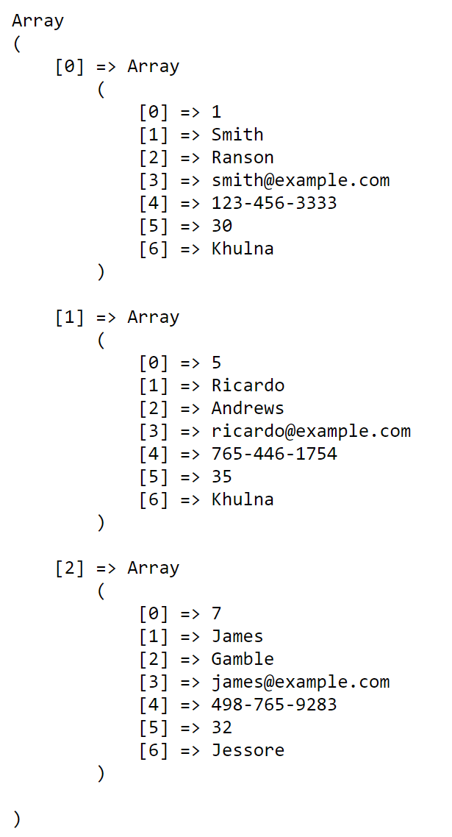
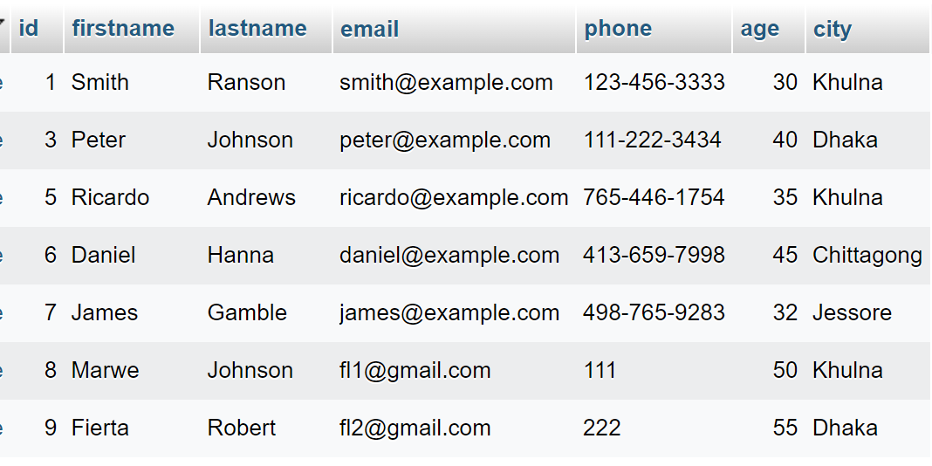
Use WHERE BETWEEN
$statement = $conn->prepare("SELECT * FROM students
WHERE age BETWEEN ?AND ?");
$statement->execute([30,36]);
$result = $statement->fetchAll(PDO::FETCH_NUM);

Slide 6
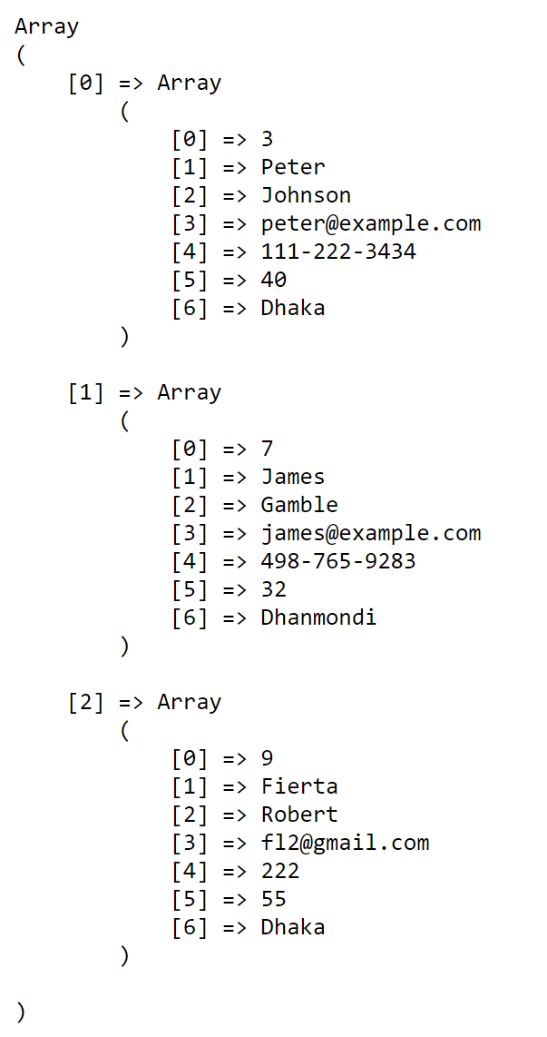
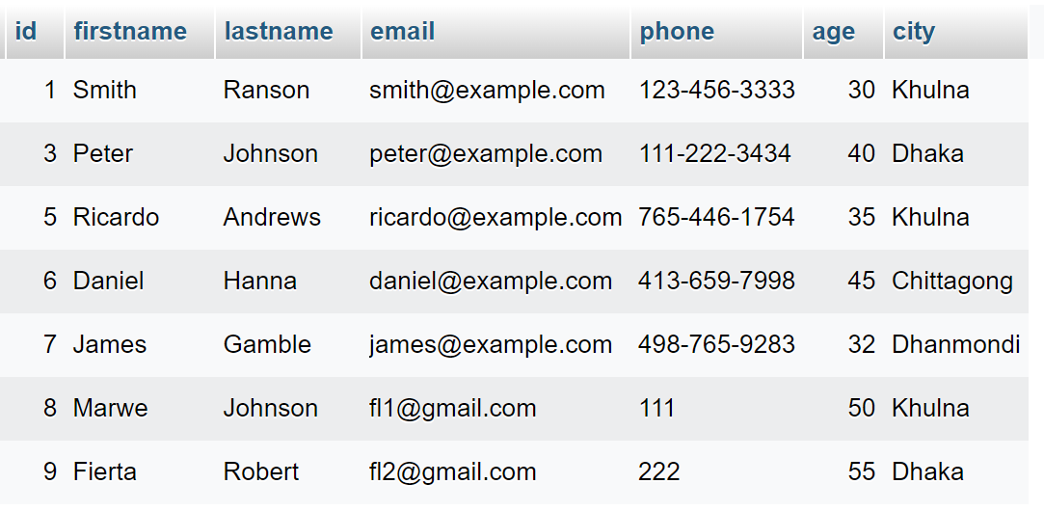
Use WHERE LIKE
$statement = $conn->prepare("SELECT * FROM students WHERE city LIKE ?");
$statement->execute(['d%']);
$result = $statement->fetchAll(PDO::FETCH_NUM);

Slide 7
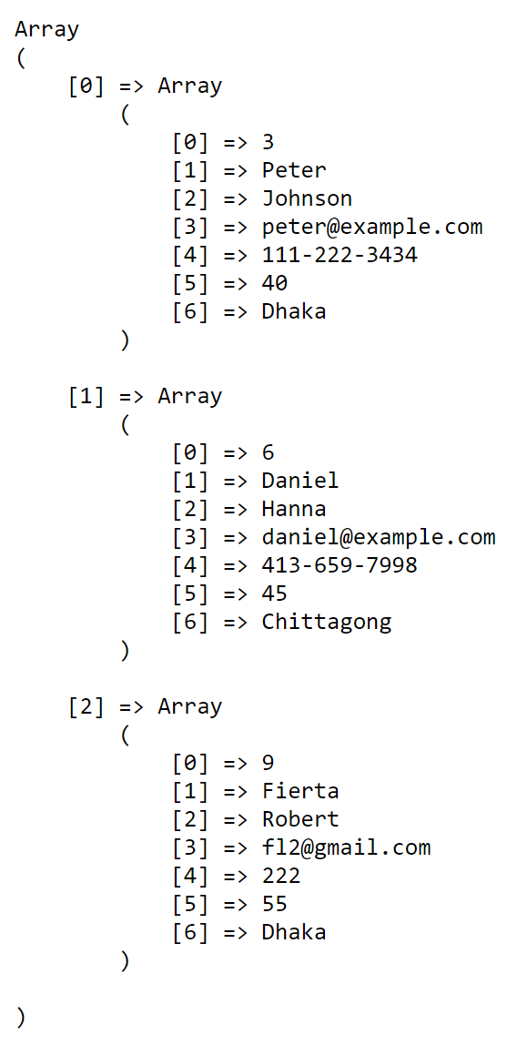
Use WHERE IN
- List all students from Dhaka or Chittagong.
$statement = $conn->prepare("SELECT * FROM students WHERE city IN (?,?)");
$statement->execute(['Dhaka','Chittagong']);
$result = $statement->fetchAll(PDO::FETCH_NUM);

Slide 8
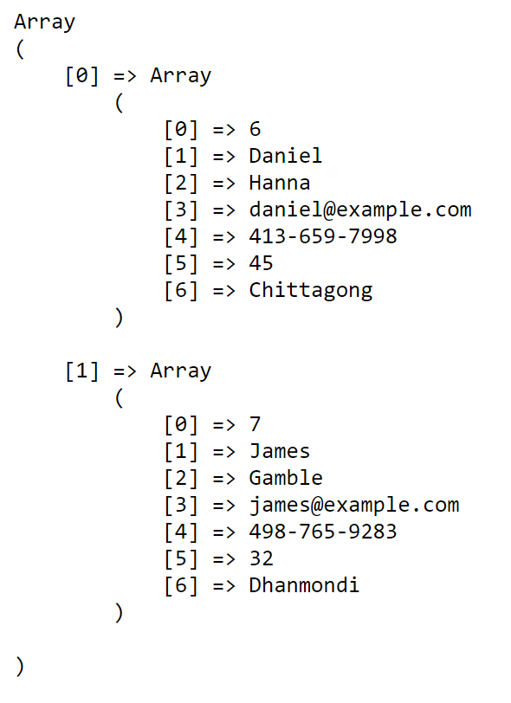
Use WHERE NOT IN
- List all students who are not in Dhaka or Khulna.
$statement = $conn->prepare("SELECT * FROM students WHERE city NOT IN (?,?)");
$statement->execute(['Dhaka','Khulna']);
$result = $statement->fetchAll(PDO::FETCH_NUM);

Slide 9
Use WHERE IN Subquery
- List all students that are from the same cities as where the institutes are.
$statement = $conn->prepare("SELECT firstname,city
FROM students
WHERE city IN (
SELECT institute_city FROM institutes
)
");
$statement->execute();
$result = $statement->fetchAll(PDO::FETCH_NUM);

Slide 10
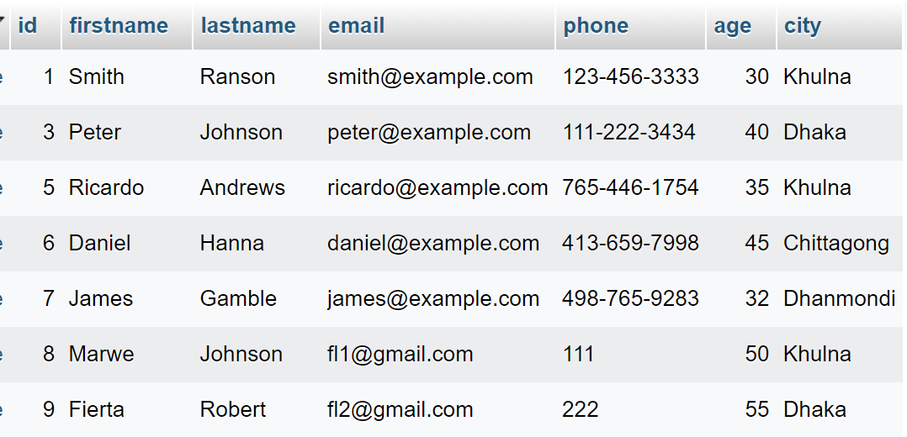
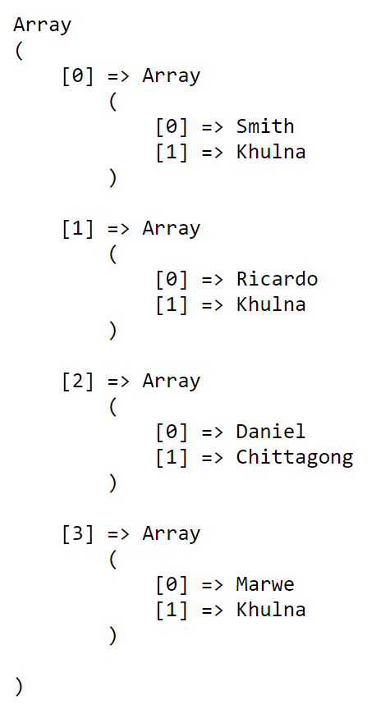
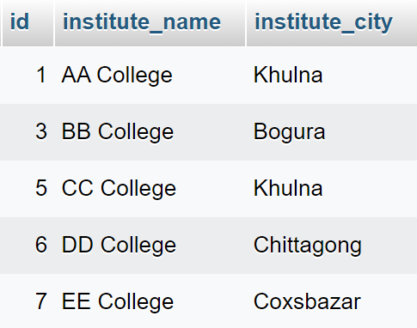
Use WHERE IN Subquery (…)

